Slide 1


Integrated Space Weather Analysis Support:
Super Timeline Cygnet
Community Coordinated Modeling Center
Patrick Zhou
University of Maryland, College Park
Science and Engineering Student Internship

Slide 2


Presentation Overview
CCMC
  What It Does, Why We Need It
iSWA
  Background
Super Timeline Cygnet
  Purpose
  Development
  Demonstration

Slide 3
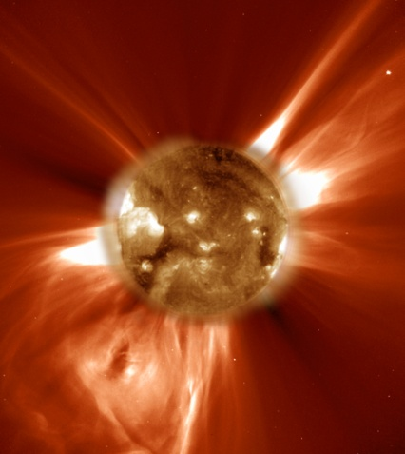
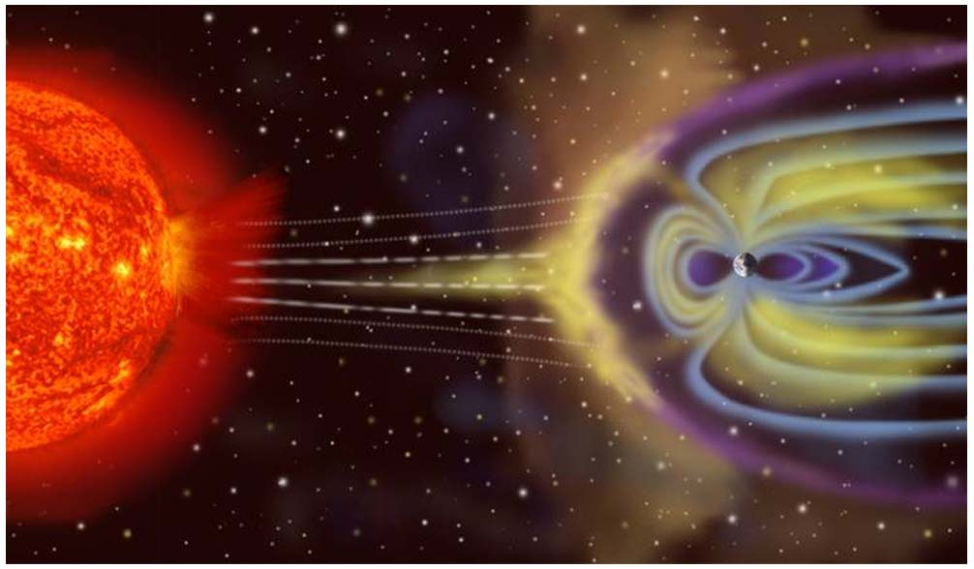
What is the CCMC? Why is it needed?
The Sun is the source of all space weather
  Solar flares and Coronal Mass Ejections (CME) pose a threat to power grids
  Satellite failures (Reduced Lifetime)
  Communications and GPS blackouts
  Particle hazardous to astronauts and polar flight passengers
The Community Coordinated Modeling Center (CCMC) is a multi-agency partnership that:
  Provides modern space research models to the scientific community
  Tests and evaluate models
  Supports Space Weather forecasters and science missions

Slide 4
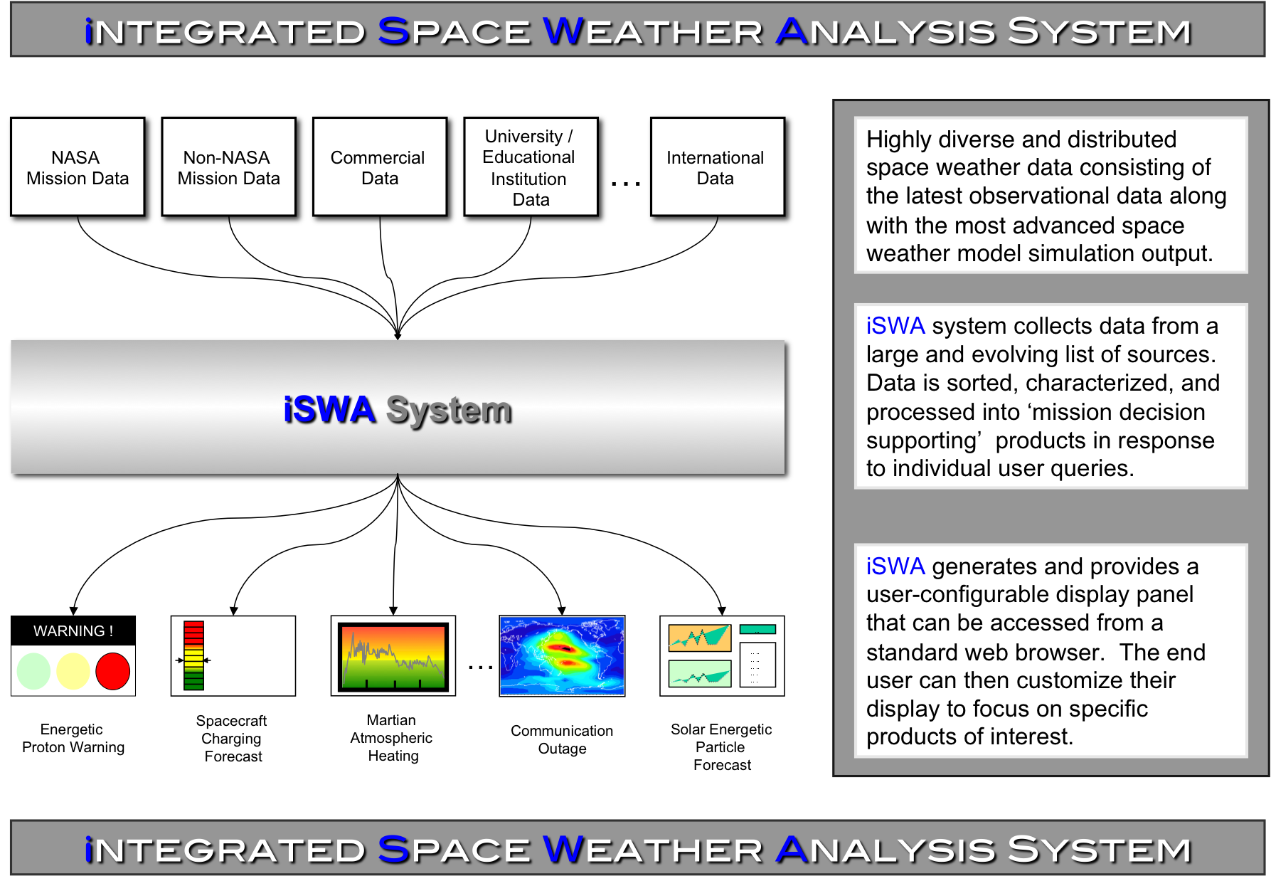

Slide 5
Super Timeline Cygnet
What is the Super Timeline Cygnet?
  Interactive Graph App that allows viewing of custom data points o
    Data points are consisted of “pairs” comprised of resources and quantities
      Resources defined as source of data, i.e. observatories, satellites
Advantages:
  Provides users more flexibility and control over graphs
  Eliminates need for hard-coded, fixed graphs
  Interactive graph, i.e, zoom, scroll over legend, linear to log scale, color
  Dynamically updates when database updates with new data. Graph updates on the fly as new real-time data is added in data.

Slide 6
Development
Cygnet Process:
Based off original Timeline Cygnet
Written in Javascript/Java
Servlets retrieve data from iSWA database
Cygnet dynamically creates data select table with known pairs
Waits for user to select desired data
Servlets retrieve specific data from database
Cygnet creates/updates graphs and settings
Obtain all possible data pairs from iSWA database from servlet
Dynamically updates data select table
Waits for user input
Creates / updates graphs

Slide 7
Demonstration

Slide 8
Summary
Successfully created and implemented Super Timeline Cygnet
Will release on live iSWA servers as alpha or beta version
Super Timeline Cygnet anticipated by users world-wide
Future work:
  Implementation of custom color scheme for users
  Polishing Cygnet
  Bug fixing

Slide 9
Special Thanks
Mentor – Peter MacNeice
Marlo Maddox, David Berrios, Richard Mullinax
Director of CCMC – Michael Hesse
Ekaterina Verner
SESI

